Slide 1
Text Classification
Project Digital Egypt Pioneers Initiative
AWS Machine Learning Track

Slide 2
Project Overview :
Goal : Build a text classification model to categorize news articles
Dataset : BBC news dataset (text and category columns)
Tools & Technologies :
Python (Pandas – numpy)
Visualization (Matplotlib – Seaborn)
TensorFlow / Keras
Nltk
Colab for training and experimentation

Slide 3
Week 01
Week 02
Week 03
Setup Data Preparation
Model Development
Pipeline Integration

Slide 4
01
Setup & Data Preparation

Slide 5
01 | Importing - Loading :
Importing Libraries :
Python (Pandas – numpy)
Visualization (Matplotlib – Seaborn)
TensorFlow / Keras
Nltk
Loading Data :
Loaded BBC News dataset from Google Drive
Previewed the data

Slide 6
01 | Data Analysis :
Data Analysis :
Shape of the data : [ 2225 rows , 2 columns ]
Category column have 5 unique category
[ 'tech', 'business', 'sport', 'entertainment', 'politics’ ]
The sport category has the highest representation in data
One of the insights from the summary statistics specially through the value counts :
'sport’ - 511
'business’ – 510
'politics’ – 417
'tech’ – 401
'entertainment’ - 386

Slide 7
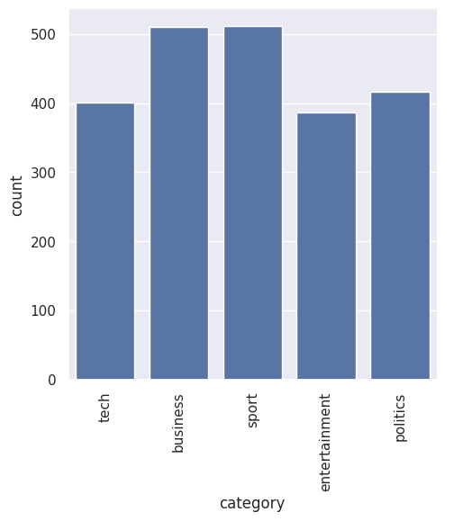
Distribution !
This plot visualize the distribution of news
category highlight any imbalances between the different classes........

Slide 8
01 | Data Preprocessing :
Tokenization and label Encoder of text sequence.
A vocabulary size of 1000 was set to limit the number of unique words used by the model.
Each sentence in the dataset was converted into a sequence of integers, where each integer represents a word’s index in the tokenizer’s vocabulary.
Encoder the train data and test data
convert the labels to one-hot encoded vectors

Slide 9
01 | Data Preprocessing :
Removed stopwords and Preprocessed sentences.
Common stopwords like “a,” “the,” and “is” were removed from the text to reduce noise. This helps focus on the most important words for classification.
A set of English stop words was created using nltk, eliminating these uninformative words before tokenization.

Slide 10

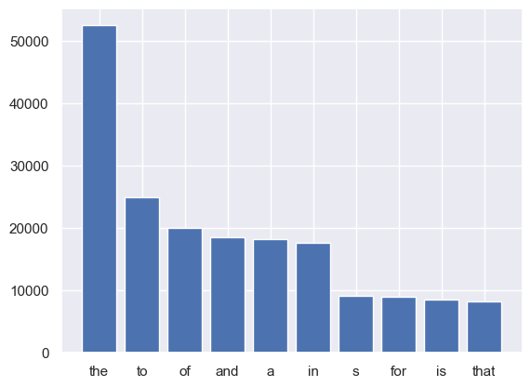
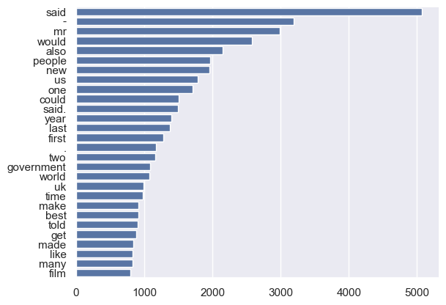

This plot visualize the distribution of top ten most frequently stop words in the data
This plot visualize the distribution of number of the frequency of words in the data

Slide 11
01 | Data Preprocessing :
Splitting the data :
Training set : 80% of the total data, which contains 1780 samples.
Validation set : 20% of the total data, which contains 445 samples.

Slide 12
2225
1780
445
Total Samples
Training Samples
Validation Samples

Slide 13
02
Model Development

Slide 14
Building the Model
1- Model Initialization: Creates a sequential model.
2- Layers :
2.1- Dense Layers: The first dense layer has 512 neurons, accepting input with shape defined by max_words = 1000.
2.2- Activation Functions: ReLU is used for hidden layers .
2.3- Dense Layers: The final dense layer outputs the number of classes.
2.4- Dense Layers: applies the softmax activation function, which converts the output into a probability (multiclass – single class)

Slide 15
Model summary
provides a summary of the model architecture, including the number of layers, output shapes, and the total number of parameters.
total params : 515,077
Trainable params : 515,077
Non-trainable params : 0

Slide 16
Compile the Model
Loss Function: Loss='categorical_crossentropy': Measures difference for multi-class classification.
Optimizer:
optimizer='adam': Adaptive learning rate
optimizer for improved convergence.
Metrics:
metrics=['accuracy']: Tracks accuracy
during training.

Slide 17
Model Training
Training:
Batch size : 32
Epochs: 2
-For first epoch
loss: 0.3799 , accuracy: 0.8908 -
val_loss: 0.1342 , val_accuracy: 0.9607
-For second epoch
loss: 0.0393 , accuracy: 0.9950
val_loss: 0.1096 , val_accuracy: 0.9663

Slide 18
Model Architecture
Sequential Model Includes:
Dense Layers: Fully connected neurons.
ReLU Activation: Introduces non-linearity.
Dropout Layer: Regularization to avoid overfitting.
Softmax Activation: Multi-class output.

Slide 19
Model evaluation
accuracy: 96.87 %
loss: 0.1186 %

Slide 20
Simulation Experiment Overview
Objective: To evaluate the performance of the text classification model by comparing its predictions against actual labels on test samples.

Slide 21
Actual vs. Predicted Labels
Comparison: For each test sample, the actual label is retrieved from the test dataset.
Both the actual and predicted labels are printed
for direct comparison, allowing us to assess the
model’s accuracy.

Slide 22
Insights from Results
Outcome:
This process provides insight into how well the model performs on unseen data.
By examining the actual vs. predicted labels, we can identify areas of strength and potential misclassifications in the model.

Slide 23
03
Pipeline Integration

Slide 24
Link the video
https://drive.google.com/file/d/10iT63G8nFzaDJaQT31-uIbyuNZNtUhnD/view?usp=drive_link

Slide 25
Thank you

